Slide 1

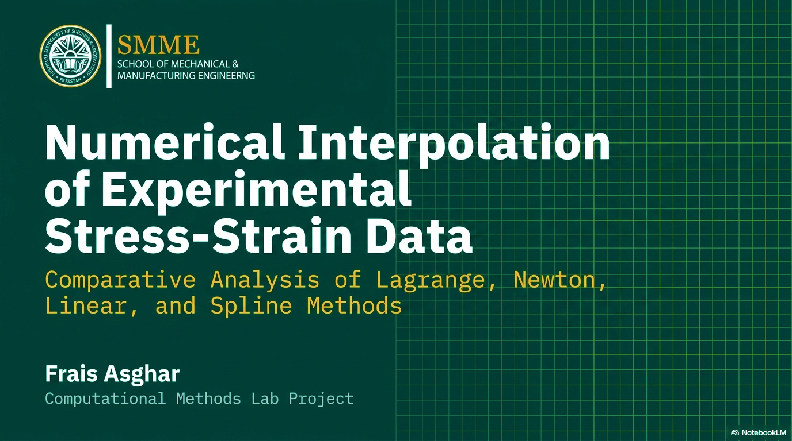
| CMS: 516900 | ME-16A

Slide 2
Project Outline
Introduction & Problem Statement
Experimental Data
01
02
Why interpolation matters in engineering
Stress-strain dataset of copper alloy
Mathematical Theory
MATLAB Implementation
03
04
Lagrange, Newton, Linear, Cubic Spline
Code walkthrough for all 4 methods
Results & Comparison
Error Analysis
05
06
Interpolated values at query points
Absolute differences vs. Spline reference
Plots & Discussion
Conclusions
07
08
6 figures: individual + combined overlays
Key findings and best method for engineering
Frais Asghar | CMS: 516900 | ME-16A

Slide 3
Introduction
What is Interpolation?
Interpolation estimates unknown values between known discrete data points. In engineering, experiments produce data at fixed measurement points, interpolation bridges the gaps to provide continuous estimates.
Project Objectives
01
Lagrange Interpolation
02
Newton Divided Difference
03
MATLAB interp1 – Linear
04
Cubic Spline
Implement from first principles using basis polynomials.
Build full divided-difference table, display Newton form.
Apply piecewise linear interpolation via MATLAB built-in Commands.
Fit smooth C²-continuous spline using MATLAB interp1.
05
Graphs & Comparison
Compare all methods through tables, plots, and overlay graphs
Frais Asghar | CMS: 516900 | ME-16A

Slide 4
Experimental Data (Copper Alloy Stress-Strain)
9 data points collected from uniaxial tensile testing of a copper alloy, covering elastic and early plastic deformation regimes.
Point
Strain ε (-)
Stress σ (MPa)
Key Features of the Dataset
P1
0.00
0
Elastic Region
P2
0.02
50
Steep rise from ε = 0 to 0.05 (slope ~ 2200 MPa)
P3
0.05
110
Strain Hardening
P4
0.08
160
Gradual plateau from ε = 0.10 to 0.30
P5
0.12
200
FCC Metal Behavior
P6
0.16
230
Decreasing tangent modulus — typical of copper alloys
P7
0.20
250
Data Range
P8
0.25
265
Strain: 0.00 – 0.30 | Stress: 0 – 275 MPa
P9
0.30
275
Dataset Size
9 discrete points → degree-8 global polynomial
Frais Asghar | CMS: 516900 | ME-16A

Slide 5
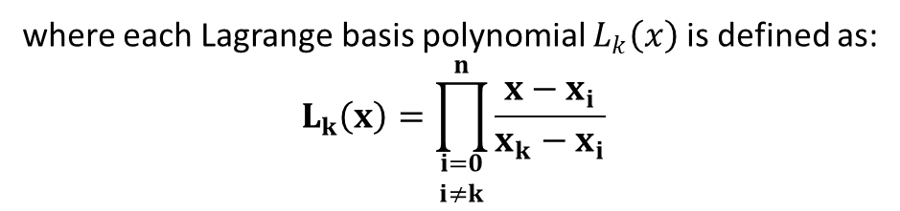

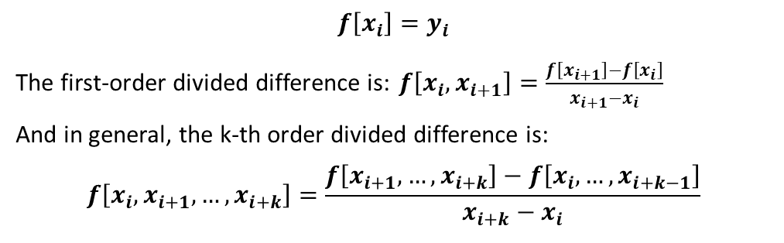
Mathematical Theory – Polynomial Methods
① Lagrange Interpolation
② Newton's Divided Difference
$$P\left(x\right)=\sum_{k=0}^{n}{y_{k}} L_{k}\left(x\right)$$
$$P\left(x\right)=f\left[x_{0}\right]+f\left[x_{0},x_{1}\right]\left(x−x_{0}\right)+f\left[x_{0},x_{1},x_{2}\right]\left(x−x_{0}\right)\left(x−x_{1}\right)+…+f\left[x_{0},x_{1},…,x_{n}\right]$$
$$f\left[x_{i}\right]=y_{i}$$
The first-order divided difference is: $f\left[x_{i},x_{i+1}\right]=\frac{f\left[x_{i+1}\right]−f\left[x_{i}\right]}{x_{i+1}−x_{i}}$
And in general, the k-th order divided difference is:
$$f\left[x_{i},x_{i+1},…,x_{i+k}\right]=\frac{f\left[x_{i+1},…,x_{i+k}\right]−f\left[x_{i},…,x_{i+k−1}\right]}{x_{i+k}−x_{i}}$$
where each Lagrange basis polynomial $L_{k}\left(x\right)$is defined as:
$$L_{k}\left(x\right)=\prod_{\begin{matrix}i=0 \\ i≠k\end{matrix}}^{n}{\frac{x−x_{i}}{x_{k}−x_{i}}}$$
Key Properties:
Lₖ(xₖ) = 1 at the k-th node
Lₖ(xᵢ) = 0 at all other nodes
Passes exactly through all n+1 points
Degree = n → 9 pts = degree-8 polynomial
Risk: Runge's Phenomenon (oscillation at
endpoints) with dense high-degree polynomials
Divided Differences (recursive):
f[xᵢ] = yᵢ (0th order)
f[xᵢ, xᵢ₊₁] = (f[xᵢ₊₁]−f[xᵢ]) / (xᵢ₊₁−xᵢ) (1st)
Higher orders computed similarly
Advantage: Adding a new data point only requires ONE new row — very efficient!
Mathematically identical to Lagrange
Frais Asghar | CMS: 516900 | ME-16A

Slide 6
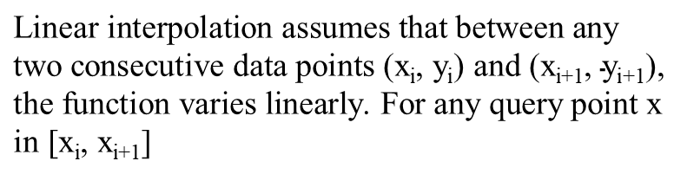
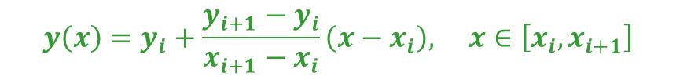
Mathematical Theory – MATLAB interp1 Methods
③ Linear Interpolation (interp1 'linear')
④ Cubic Spline (interp1 'spline')
$$y\left(x\right)=y_{i}+\frac{y_{i+1}−y_{i}}{x_{i+1}−x_{i}}\left(x−x_{i}\right), x∈\left[x_{i},x_{i+1}\right]$$
S_{i}(x) = a_{i} + b_{i}(x − x_{i}) + c_{i}(x− x_{i})² + d_{i}(x − x_{i})³
$$\text{Linear} \text{interpolation} \text{assumes} \text{that} \text{between} \text{any} \text{two} \text{consecutive} \text{data} \text{points}\text{ (}\text{xi}\text{, }\text{yi}\text{) }\text{and}\text{ (}\text{xi}\text{+1, }\text{yi}\text{+1),} \text{the} \text{function} \text{varies} \text{linearly}\text{. }\text{For} \text{any} \text{query} \text{point} \text{x} \text{in}\text{ [}\text{xi}\text{, }\text{xi}\text{+1]}$$
A cubic spline S(x) is a piecewise-cubic polynomial defined on each sub-interval [x_{i}, x_{i+1}] that satisfies:
Characteristics:
• Piecewise first-degree polynomial
• Numerically stable and very fast
• Produces visible kinks at knot points
(discontinuous first derivative)
• Cannot capture smooth nonlinear curvature
Best used for: Quick estimates, simple datasets,
or when speed matters more than accuracy.
Continuity Conditions Enforced:
S(xᵢ) = yᵢ (passes through all points)
S(x) continuous (no gaps)
S′(x) continuous (smooth slope at knots)
S″(x) continuous (smooth curvature — C²)
MATLAB uses not-a-knot boundary conditions.
★ BEST method for smooth engineering data, physically realistic & accurate!
Frais Asghar | CMS: 516900 | ME-16A

Slide 7
MATLAB Implementation – Code Overview
① Lagrange (Anonymous Function)
② Newton Divided Difference
lagrange = @(xd,yd,xq) arrayfun(@(xi) ... sum(yd .* arrayfun(@(k) prod((xi-xd([1:k-1,k+1:end])) ./ ... (xd(k)-xd([1:k-1,k+1:end]))), 1:length(xd))), xq); y_lagrange = lagrange(x_data, y_data, x_query);
dd = zeros(n,n); dd(:,1) = y_data(:); for j = 2:n for i = j:n dd(i,j) = (dd(i,j-1)-dd(i-1,j-1)) / (x_data(i)-x_data(i-j+1)); end end coeff = diag(dd); % Newton coefficients
③ Linear Interpolation
④ Cubic Spline
y_linear_fine = interp1(x_data, y_data, x_fine, 'linear'); y_linear_query = interp1(x_data, y_data, x_query, 'linear');
y_spline_fine = interp1(x_data, y_data, x_fine, 'spline'); y_spline_query = interp1(x_data, y_data, x_query, 'spline');
Frais Asghar | CMS: 516900 | ME-16A

Slide 8
Results – Interpolated Stress Values at Query Points
Strain ε
Lagrange (MPa)
Newton (MPa)
Linear (MPa)
Spline (MPa)
0.01
25.21
25.21
25.00
25.14
0.03
82.51
82.51
82.67
82.73
0.06
136.14
136.14
135.00
135.89
0.10
181.08
181.08
180.00
181.02
0.14
216.05
216.05
215.00
216.01
0.18
240.98
240.98
240.00
240.91
0.22
257.63
257.63
257.00
257.58
0.27
270.31
270.31
270.33
270.25
Key Observations:
Lagrange & Newton produce identical results, confirms both implementations are correct.
Cubic Spline and polynomial methods agree closely at interior points (within 0.3 MPa).
Linear interpolation deviates most in curved region (up to ~1 MPa error at ε = 0.10–0.14).
Frais Asghar | CMS: 516900 | ME-16A

Slide 9
Error Analysis. Absolute Difference vs. Cubic Spline Reference
Strain ε
|Err| Lagrange (MPa)
|Err| Newton (MPa)
|Err| Linear (MPa)
0.01
0.0700
0.0700
0.1400
0.03
0.2200
0.2200
0.0600
0.06
0.2500
0.2500
0.8900
0.10
0.0600
0.0600
1.0200
0.14
0.0400
0.0400
1.0100
0.18
0.0700
0.0700
0.9100
0.22
0.0500
0.0500
0.5800
0.27
0.0600
0.0600
0.0800
Lagrange & Newton:
Max error ~0.22 MPa — very close to spline everywhere.
Linear Interpolation:
Max error ~1.02 MPa at ε=0.10 (red cells), misses curvature.
Reference Method:
Cubic Spline — smoothest, C² continuous, physically most accurate.
Frais Asghar | CMS: 516900 | ME-16A

Slide 10
Method Comparison – Summary
Criterion
Lagrange
Newton
Linear
Spline
Accuracy (smooth data)
High
High
Moderate
Very High
Smoothness of curve
Smooth
Smooth
Piecewise
C² Continuous
Ease of adding points
Hard
Easy
Easy
Moderate
Risk of oscillation
Yes (Runge)
Yes (Runge)
None
Minimal
Best for engineering?
Sometimes
Sometimes
Simple cases
✓ YES
Identical to other?
= Newton
= Lagrange
—
—
Frais Asghar | CMS: 516900 | ME-16A

Slide 11
Plots & Graphical Results. 6 MATLAB Figures
Figure 1
Lagrange Interpolation
Figure 2
Newton Divided Difference
Figure 3
Linear Interpolation (interp1)
Smooth degree-8 global polynomial. Runge oscillation may appear near endpoints but fits all data points exactly.
Curve overlaps Lagrange perfectly mathematically identical polynomial. Confirms both implementations.
Piecewise straight lines. Visible kinks at each knot point. Simple but misses nonlinear curvature.
Figure 4
Cubic Spline (interp1)
Figure 5
2×2 Subplot Layout
Figure 6
Combined Overlay Graph
Smoothest curve with continuous curvature (C²). Best physical representation. Recommended for engineering.
All four methods on one page for easy side-by-side visual comparison.
All four curves on one graph with distinct line styles and colors. Annotation highlights Lagrange≈Newton.
Frais Asghar | CMS: 516900 | ME-16A

Slide 12
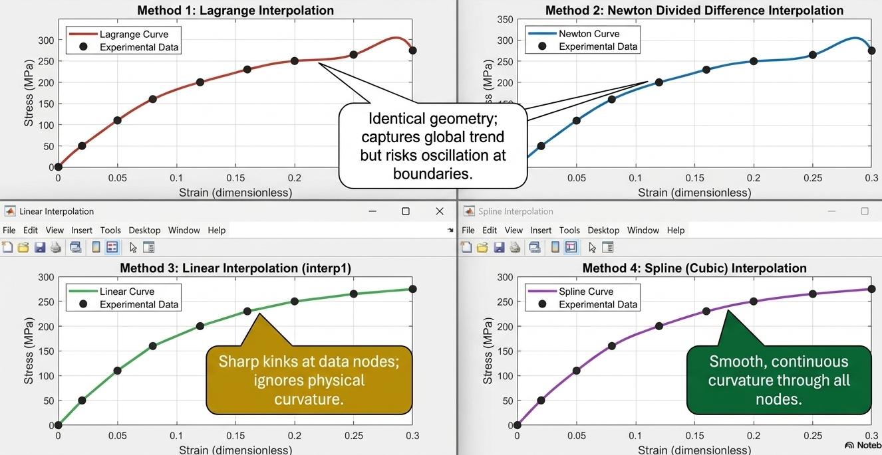
Graphs Comparison
Frais Asghar | CMS: 516900 | ME-16A

Slide 13
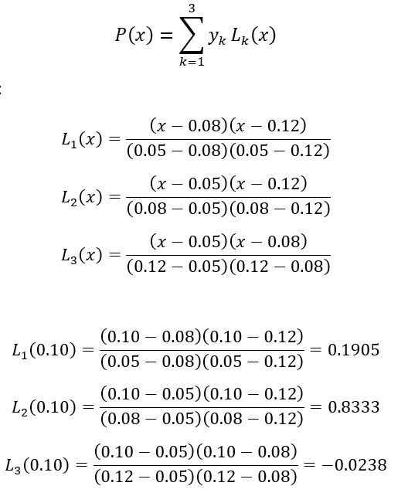
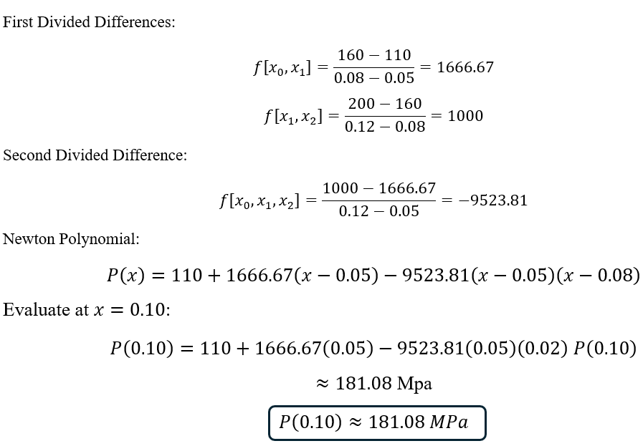
Manual Calculation – Estimating Stress at ε = 0.10
Using 3 nearby data points: P3 (0.05, 110), P4 (0.08, 160), P5 (0.12, 200)
Lagrange Basis Polynomials
Newton Divided Difference
Both methods agree: P(0.10) ≈ 181.08 MPa — confirms correctness!

Slide 14
Physical Interpretation & Discussion
Material Behavior of the Copper Alloy
The stress-strain curve shows a steeply rising elastic region (ε = 0–0.05), then transitions to a gradual strain-hardening plateau (ε = 0.10–0.30). The decreasing tangent modulus is characteristic of Face-Centered Cubic (FCC) metals like copper.
Engineering Applications of Interpolation
FEA Input
Fatigue Life
Process Sim.
Provides continuous material model for Finite Element Analysis simulations
Enables stress estimation at any strain for fatigue and fracture calculations
Supports forming and machining process simulation requiring smooth curves
Key Observations
Lagrange & Newton are mathematically identical → curves overlap perfectly in all plots.
Linear interpolation is least smooth — cannot capture the nonlinear strain-hardening behavior.
Cubic Spline gives the most physically realistic result (continuous curvature, no oscillation).
All methods reproduce the experimental data exactly at every given data point by construction.
Frais Asghar | CMS: 516900 | ME-16A

Slide 15
Conclusions
✓
All four methods accurately interpolate the given experimental data points.
✓
Cubic Spline is the most suitable method — C² continuous, physically realistic, minimal oscillation.
✓
Lagrange & Newton produce identical results, confirming both implementations are correct.
✓
Linear interpolation is simple and stable but misses smooth nonlinear material behavior.
✓
High-degree global polynomials (Lagrange/Newton) risk Runge's phenomenon with dense data.
Future Work:
Higher-density data • Hermite splines (with derivative info) • 2D surface interpolation for biaxial stress
Numerical Analysis Lab Project | Frais Asghar | CMS: 516900 | ME-16A

Slide 16




Thank You
Project Lead
Engineering Domain
Project Date
Frais Asghar
MATLAB Project
April 2026
Questions & Feedback Welcome

